Slide 1
Asp.Net
Ch. 04
Master Pages And Theme Caching, Application Pages AND Data
MONARCH Sankul - Lathi
Notes:
ASP.NET [ Master Pages and THEMES ]
Ch - 5

Slide 2
What is Master Page ?
A Master Page enables you to share the same content among multiple content pages in a website.
We can use a Master Page to create a common page layout.
For example,
  If we want all the pages in our website to share a three-column layout, we can create the layout once in a Master Page and apply the layout to multiple content pages.

Slide 3
Understainding Master Page
First we need to identify the controls that we need to display on all pages and then add these controls to the master page.
Then we need to create a ContentPlaceHolder control for the master page to place the content of the Web Page.
When we execute this website, then the layout of master page and the content in ContentPlaceHolder control are merged to display the out of a web page.

Slide 4
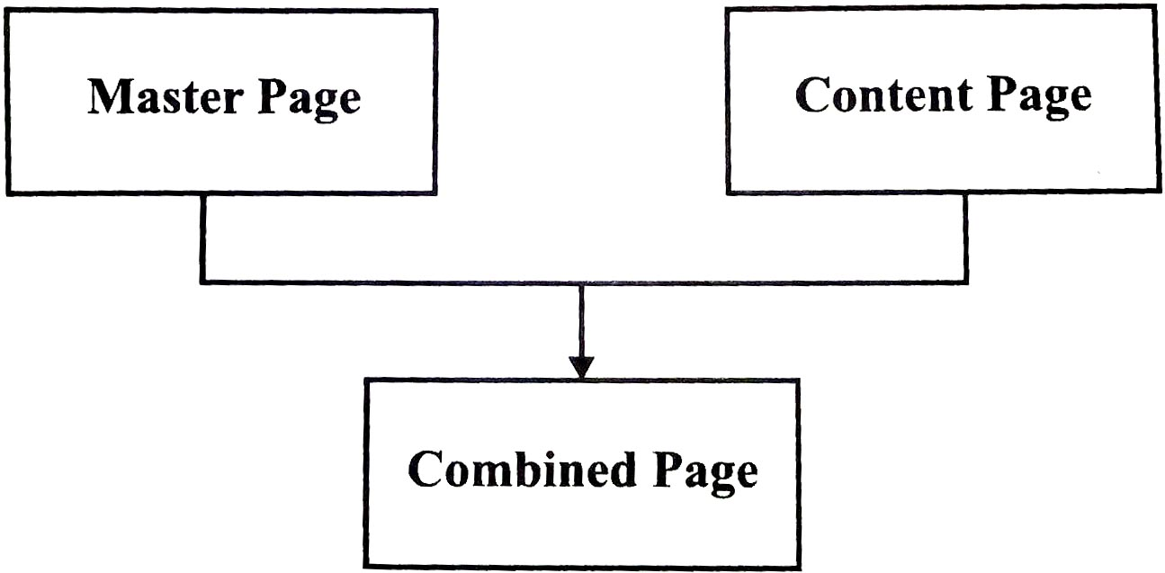
Understainding Master Page

Slide 5
Requirement of Master Page :
Master page provides centralize common functionality of various pages used in Web Application such that if we make change in one place it would be updated everywhere.
It makes it easy to create a set of controls and code which applied to a set of a pages.
For example, We can create a common menu for all pages.

Slide 6
Requirement of Master Page :
The Master Page Object models allows us to make changes to the master page from individual content page which in turn allows us to have fine grained control over the rendering of the final page.
Since most of UI code is in the Master Page, the size of content pages will be very small.

Slide 7
Creating Master Page…
We can create a Master Page by creating a file that ends with the .master extension.
Master page has a predefined layout that includes,
  Static text
  HTML elements and
  Server Controls
The Master page is identified by a special @Master directive. In ordinary .aspx page we have @page directive.

Slide 8
Creating Master Page…
The @Master directive looks like the following :
  <%@Master Language="C#" AutoEventWireup="true" CodeFile="MasterPage.master.cs" Inerits="MasterPage" %>
The above property indicates :
  Language indicates the language in which the page is written.

Slide 9
Def. Create a Master Page and try to run it.
Step-1
  Create a new WEBSite.
Step-2
  Add New Master Page.
Step-3
  Design the master page with required controls.
Try to Execute the PROGRAM…!

Slide 10
Creating Content Page
The content for the Master Page's PlaceHolder controls are created by placing individual content pages, which are ASP.NET pages.
These page are bounded to a specific master page. The binding is established by using @Page directive of content page.
  <%@Page Language="C#" MasterPageFile="~/MasterPage.Master" AutoEventWireup="True" CodeFile="Default.aspx.cs" Inherits="_Default" %>

Slide 11
Def. Create a Content PAGE of a Master Page.
Step-1
  Select A MasterPage, then right click on the masterpage. It will display a list of items. Select Content Page.
Step-2
  Set required contents in that page.
Step-3
  Run the Page and check output.

Slide 12
Understanding Themes :
A theme is a collection of property settings which allows us to define the look of pages and controls, and then apply that look consistently through all the Web pages in the web application.
Themes are made of different set of elements such as Skins, Cascading Style Sheet(CSS), images and other resources.
Themes are mostly defined in special directories.

Slide 13
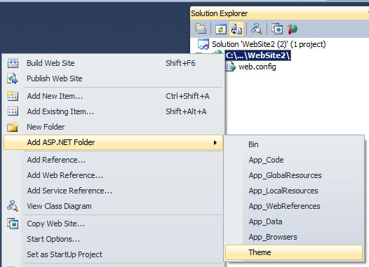
Create New Theme :
  If there is no Theme folder in solution explorer. Then Right Click on project title.
  Select…
Add
ASP.Net
Folder
Add Theme.
This Theme will create a new theme folder in solution explorer.

Slide 14
Elements of Themes :
Skins
Casecading Style Sheet (CSS)
Images and other Resources
  Skins
    A skin file has an extension .skin and contains property settings for individual web controls of the page.
    A .skin file can have more than one control skins for one or more control types.
    We can define skins in a separate file for each control or can combine all the skins in a single file.

Slide 15
Elements of Themes : Skin
Skin for Control
Example :
  <asp:button runat=“server”
  BackColor=“lightblue”
  ForeColor=“Black”/>
There are two types of control skins,
  Default Skin
  Named Skin

Slide 16
Elements of Themes : Skin
Default Skin
  A default skin is automatically applied to all controls of the same type when a theme is applied to a page.
  A control skin is a default skin.
  Default skin does not have a SkinID.
Named Skin
  A named skin is a control skin with a SkinID property set. Named skins do not automatically apply to controls by type.

Slide 17
Create SKIN : Default SKIN
Right click on Theme.
Select Add New ITEM.
Select SKIN File with .skin extension.
Put required formatted (Backcolor, ForeColor etc.) SKIN controls.
  Like,
    Label, Textbox, Button (Put it without ID and Text properties.)
Put these all controls under skin file default <% … %> code.

Slide 18
Apply theme to WEBPAGE.
To apply any theme to any web page we have to add…
  Theme=“<theme name>”
  In, Webpage Page Directives.
  Example :
    <%@ Page Language="C#" Theme="ThemeName" AutoEventWireup="true" CodeFile="Default.aspx.cs" Inherits="_Default" %>

Slide 19
NOTE : Theme + Skin
When we execute the web page then and then only the SKIN effect will be displayed on the controls.

Slide 20
Named SKIN = SkinID
We can add SkinID in any theme control.
  Just add new property in control with name SkinID=“IDName”.
  If your control skin is without SkinID then it will be default skin.
  If your control skin is with SkinID then it will be Name Skin. We have to add SkinId property in control of WEBPAGE.

Slide 21
In SHORT : Apply SKIN file...
Add Skin File in current THEME Folder...
Insert in page directive theme...
Now add required controls to the .skin file
Example 1:
  <asp:Label runat="server" ForeColor="Red"/>
  Note :
  This skin will apply on all the label control
Example 2:
  <asp:Label runat="server" ForeColor="Red" SkinID="lblLabel" />
  Note :
  This skin will apply to only those labels which has SkinID="lblLabel"

Slide 22
Elements of Themes : CSS
Casecading Style Sheet (CSS):
  A theme can also include a CSS file.
  We can define the CSS files in theme folder.
  When we put a “.css” file in the theme folder, the style sheet is applied automatically as part of the theme.
Images and Other Resources :
  We can also include graphics and other resources, such as script files or sound files.
  Mostly the resource files are located in the same folder as the skin file for that theme.

Slide 23
Types of Themes :
There are two types of Themes :
  Page Themes
  Global Themes
Page Themes :
  A page theme is a theme folder with control skins, style sheets, graphics files and other resources which are created as a sub folder of the \App_Themes in our web application.
  Each theme is a different subfolder of the \App_Themes folder.

Slide 24
Types of Themes :
Global Themes
  A global theme is a theme that is applied to all web sites on a server.
  Global themes allows us to define an overall look for the domain which has multiple websites.
  Global themes are like page themes they also include control skins, style sheets, graphics file and other resources.
  Global themes are stored in a folder named themes. This folder is global to the web server.
  Any website or page in the website on this server can reference global theme.

Slide 25
Applying Themes :
We can apply themes to various pages or web applications by using theme or StyleSheetTheme attribute.
Global Themes can be applied setting the <pages> element in Web.Config file.
A theme setting in the Web.Config file is applied to all ASP.NET Web Pages in the current web application. It can be done by adding the following code in Web.Config file.

Slide 26
Applying Themes :
Apply Themes to Web.Config
  <configuration>
  <system.web>
  <pages theme="ThemeName"/>
  </system.web>
  </configuration>

Slide 27
Applying Themes :
Apply styleSheetThemes to Web.Config
  <configuration>
  <system.web>
  <pages styleSheetTheme="ThemeName"/>
  </system.web>
  </configuration>
Page Themes can be applied to a Web Page in Web Application by using StyleSheetTheme or Theme attributes of the Page Directive. It can be given as :
  <%@ Page Theme="ThemeName" %>
  <%@ Page StyleSheetTheme="ThemeName" %>

Slide 28
Difference between Theme and StyleSheetTheme
The StyleSheetTheme attribute works same as the Theme Attribute.
The difference is when the attributes of a particular control are set locally on the page; the attributes are overridden by the global theme if we use the Theme attribute.
While the using StytleSheetTheme the attributes of a particular control are not overridden they remain same as that difined in the local page.

Slide 29
Difference between Theme and StyleSheetTheme
Suppose we have a text box control like the following :
  <asp:Textbox ID="txt1" Runat="server"
  ForeColor="#ffffff"/>
In above example, the ForeColor attribute is overridden by the theme if we apply theme using the theme attribute in the Page directive. If, we have applied the theme using the StyleSheetTheme attribute in the Page Directive, the ForeColor attribute remain in place, even if they are explicitly defined in the theme.

Slide 30
Themes & Cascading Style Sheet:
Themes are quite similar to CSS.
By default, the themes are defined in CSS file.
In both themes and CSS we can define a set of common attributes that can be applied to any web page.
Themes V/S Cascading Style Sheet :
  Themes can be used to define many properties of a control or a web page. Theme just not only define style properties.

Slide 31
Themes V/S Cascading Style Sheet
  Themes can include graphics.
  Themes do not cascade the way the style sheets does.
  We can define the property values locally as well as globally using Theme or StyleSheetTheme attribute.
  We can apply only one theme to each page.
  We cannot apply multiple themes to a page, while multiple style sheets can be applied to one page.

Slide 32
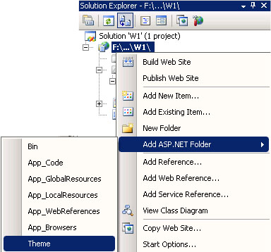
Steps-1 To Set Themes & CSS
Create a new Web Site
Right Click on the Solution Explorer and Add ASP.NET Folder, in that select theme.

Slide 33
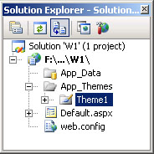
Steps-2 To Set Themes & CSS
When we click on the Theme option then automatically App_Themes folder is added to Web applicaiton.
It will also create Theme1 floder In App_Themes folder automatically.

Slide 34
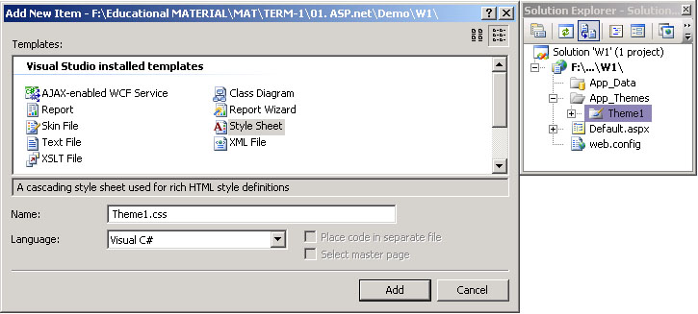
Steps-3 To Set Themes & CSS
Right click on the Theme1 Floder and add New Item and select StyleSheet and rename it as Theme1.css

Slide 35
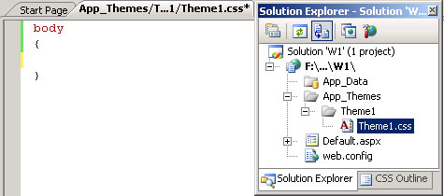
Steps-4 To Set Themes & CSS
Double click on Theme1.css
It will display a Theme page...
Add following code in the Theme1.css file.
  background-color:Red;
  background-color:Red;

Slide 36
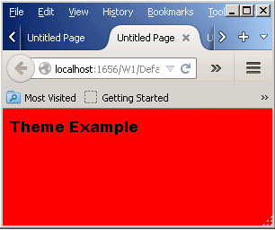
Steps-5 To Set Themes & CSS
Select .aspx file and goto page directive then add Theme="Theme1"
Add your name as Label Text and run the application.
This will display your required output....

Slide 37
Link a Style Sheet to ASP.NET page
We add a theme to ASP.NET page by setting the Theme or StyleSheetTheme attribute of @Page directive.
We can also use Link element to add link a style sheet with Web Page.
Link element is used to link the style sheet to individual ASP.NET Web Pages and apply the styles to the elements on the page.

Slide 38
Link a Style Sheet to ASP.NET page
To link a cascading style sheet to an ASP.NET Web page :
  From the Design view, from Solution Explorer, just drag the style sheet file*
  In source view, from Solution Explorer, drag the style sheet file (.css) and drop it within the <head> tag on the Web page. A new link element would be inserted inside the <head> tags, which might look like the following code example.
  <link href="/Theme1.css" rel="stylesheet" type="text/css" />

Slide 39
Class and ID Selectors :
We can also define style for Web Page by using Class and ID selectors.
The benefit of using them is that same HTML element can be presented differently depending on its Class or ID.
Class Selector :
  We can define a class selector by name preceded by a full stop (.).
  In the class selector block we can define the style we want.
    .intro{ color:red;
    font-weight: bold; }

Slide 40
Class and ID Selector :
To use this class selector, class tag would be used in HTML tags.
For example,
  If we want to use the above class tag in <p> tag, then it can be ginve as :
    <p class="intro"> This is for testing </p>
ID Selector :
  We can define an ID selector by name preceded by a hash character (#). ID tag is also used to set the style of the web page.

Slide 41
Class and ID Selector :
  It is used inside a div tag.
  An example of ID selector can be given as
    #top{ background-color: #ccc;
    padding: 20px }
  New to use this ID selector we need to define a div and assign its ID as this name
  It can be given as below :
    <div id="top">
    <h1>Test Page</h1>
    </div>

Slide 42
Class and ID Selector :
NOTE :
  ID and Class selector are usually defined inside the StyleSheet file (.CSS file) and are used on the Web Page. They can also be defined on the web page using script tag.
  The difference between an ID and a Class is that and ID as the name suggest can be used to identify one element, whereas a class can be used to identify more than one.

Slide 43
Asp.Net
Caching Application Pages and DATA
MONARCH Sankul - Lathi
Notes:
MONARCH Sankul - Lathi
ASP.NET [ Master Pages and THEMES ]
By : Gohil Manoharsinh A. [ Mo. 94292 20505 ]

Slide 44
Caching Introduction :
Caching is used by applications to store data temporarily either on Web Server or on the Client Side.
Caching is mostly used in situations where several programs continuously access the same set of data. So make data access faster, this data is stored in a cache and can be used for future purpose.
Usually the data accessing in ASP.NET is quite slow and time consuming as it involves procedure of connecting to the database and retrieving the data.

Slide 45
Caching Introduction :
Caching is one of the best alternatives to improve the performance of Web Application, as it allows to access data from cache itself, not from the Server Database or from the application.
Caching not reduces the processing time but it also reduces network traffic, hereby improving the performance of the Web Application and enhancing user experience.

Slide 46
Caching in ASP.NET
The execution of applications in ASP.NET is quite faster than the applications written in classic ASP.
With ASP.NET, caching techniques has improved dramatically.
Caching is the technique for storing the frequently used data in memory for immediate access to the request program calls.

Slide 47
Caching in ASP.NET
Caching is one of the important features available to improve performance of web applications.
It minimizes the usage of server resources for fetching frequently used data, and thus by improving the performance of the application.

Slide 48
Reason to USE Caching :
Every time the page request some information, it has to go through cycle consisting of Client, Server and Database.
Again in the response it has to go through another cycle consisting of database, server and client.
This might increase the time, which in turn affect the performance, that’s why to improve performance caching is used.

Slide 49
Reason to USE Caching :
When multiple users want to access the same information again and again at that time caching is considered as one of the important aspect.
Here, data would be cached in memory and thus avoiding the database access with every pages request, which increases the performance of the applications.

Slide 50
Advantages / Disadvantages of Caching
Advantages :
  Cache improves the performance of the Website.
  It takes heavy load or execution from the server for the repeated operations.
  It reduces load on Database or Web services.
  Storing data using cache is quite reliable.

Slide 51
Advantages / Disadvantages of Caching
Disadvantages :
  It will delay while accessing Website as the data needs to written before accessing.
  It would be an overhead for the Client to carry out this activity again and again.
  It would lead to an increase in maintenance, as the cached data need to get updated regularly.
  Again there would also scalability issues.
  (Scalability=માપનીયતા)

Slide 52
Different types of Caching :
ASP.NET provides different kinds of caching techniques to cache a completely rendered Web Page.
Caching Techniques are :
  Page Output Caching
  Partial Page Caching
  Data Caching

Slide 53
Page Output Caching :
The page output caching is one of the simplest technique of caching in ASP.NET.
In this technique complete HTML output of a rendered ASP.NET page is stored in cache and all the subsequent requests of the page are sent from the cache itself.

Slide 54
Page Output Caching :
The cache engine checks the cache for the existing page requests. This engine is also known as cache server, as it acts as a server that stores web pages and other internet content of request locally.

Slide 55
Page Output Caching :
If the engine finds a request for the requested page in the cache, the cached HTML output is sent to the client.
If no request is found, then the engine starts rendering the page again and saves a copy of the HTML output in cache.

Slide 56
Page Output Caching :
Page Output Caching is very useful when we have static pages.
As with static pages the content of the pages does not change frequently. So cache server would cache the HTML output once and for subsequent requests, the engine sends cached output.

Slide 57
Page Output Caching :
Because of static page, it reduces the load on the web server as the page is not rendered each time a request is made; it is cached from the cache server.
In Output Caching the first time Browser makes a request to ASP.NET web page.

Slide 58
Page Output Caching :
Since the web page is not stored in the cache for the first time, the cache server passes the request to requested ASP.NET page.
Now the request page would be cache and stored on the cache server.
For the next request to the same page, the output would be rendered from the Cache Server it would not go to the Requested ASP.NET page.

Slide 59
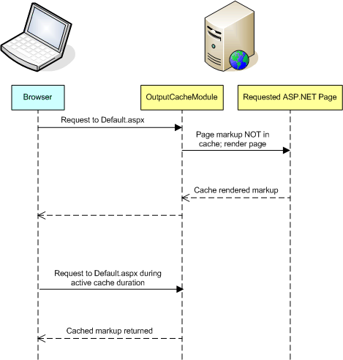
Page Output Caching :

Slide 60
Page Output Caching :
Here the cached output would be active for some duration only. So if in that duration if the output is requested then the output would be rendered from the Cache Server, else it would go the Requested Web Page.
We can implement Page Output caching by using @OutputCache directive.

Slide 61
Page Output Caching : Directive
Attribute | Description
CacheProfile | It contains various settings of the cache which are associated with a Web Page. It is an optional attribute and by default has an empty string.
Duration | It defines the time duration for the Web Page to be cached. It is required attribute. It is usually defined in seconds.
Location | It specifies the location where the cache is created. The values for this attributes are any, Client, Downstream, Server, ServerAndClient and None.

Slide 62
Page Output Caching : Directive
Attribute | Description
Nostore | It is Boolean value which determines whether to prevent secondary storage of the sensitive information.
Shared | It is a Boolean value which allows sharing of a user control output with multiple pages.
SqlDependency | It contains a string value that identifies a set of database and table name pairs on which the output cache of a control or web page depends.
VaryBy Control | It contains a semicolon separated list of strings used to vary the output cache. This attribute is used with user controls only.

Slide 63
Page Output Caching : Directive
Attribute | Description
VaryBy Custom | It defines the custom strings for custom output caching requirements.
VaryBy Header | It defines a list of HTTP headers used to vary the output cache.
VaryBy Param | It is used to cache different copies of a Web Page when it is generated dynamically, based on the parameters received from HTTP POST or GET request. It is required field.

Slide 64
Page Output Caching :
To implement Page Output Caching, add the following code at top of the Web Page to implement Page Output Caching :
  <@OutputCache Duration=“10”
  VaryByParam=“none”%>
We can also store the cached data, on client side or on the server side or proxy by using Location attribute in the @OutputCache directive.
  <@OutputCache Duration=“90” Location=“Any|Client|Downstream|Server|None” VaryByParam=“none” %>

Slide 65
Def. Demonstrate use of output caching.
Step-1
  Add a new web page.
  Put 2 Labels on that page
  Label1 with TEXT=“Output Caching 9Sec”
  Label2 with Date&Time
    Label2.Text = DateTime.Now.ToString("hh:mm:ss");
Step-2
  Add the following code below <!DOCTYPE>
<%@OutputCache Duration=“9” VaryByParam="none”%>
Step-3
  Execute and Refresh the page again & again and check the output.

Slide 66
Partial Page Caching or Fragment caching
Caching of a complete requested web page is not required always.
We may need implement caching on specific part of a web page. The remaining content of the web page would be refreshed each time the page is requested. This is called Partial Page Caching or fragment caching.

Slide 67
Partial Page Caching or Fragment caching
Step to apply partial page caching :
  Identify the parts of web page that requires more processing than the other parts, while rendering the page.
  Create user controls and decide the caching policies for them. Caching policies would check the validity of the cached data on each user request.

Slide 68
Partial Page Caching or Fragment caching
  Add the user controls in the web application. Now caching of the defined user controls would only be done. While other controls would be refreshed for each request.

Slide 69
Def. Demonstrate Partial Page Cach
Step-1
  Create a new empty website.
Step-2
  Right click on the Website Name on the Solution Explorer and add a web user control (.ascx file).
Step-3
  Check .ascx page directives.
  Ad a Label control in .ascx file & set property like, ID = lbltime, EnableViewState=False, ForeColor=Red

Slide 70
Def. Demonstrate Partial Page Cach
Step-4
  In the WebUserControl.ascx add given code.
    <%@ OutputCache Duration="5" VaryByParam="None" %>
Step-5
  In the code behind file of WebUserControl.ascx.cs add given code
    protected void Page_Load(object sender, EventArgs e)
    { lblTime.Text = DateTime.Now.ToString();
    }

Slide 71
Def. Demonstrate Partial Page Cach
Step-6
  Add new Web Form ( .aspx )
  Add WebUserControl.ascx file using @Register tag.
    <%@ Register Src="~/WebUserControl.ascx" TagPrefix="uc" TagName="UserControl" %>

Slide 72
Def. Demonstrate Partial Page Cach
Step-7
  Add Following code in default webpage.
    <div>
    Try to refresh this page, the Date time doesn't change till 5 second.
    <uc:UserControl runat="server" ID="uc1" />
    <asp:Label ID="lblTime1" EnableViewState="false" ForeColor="Blue" runat="server" Text="Label"></asp:Label>
    </div>

Slide 73
Def. Demonstrate Partial Page Cach
Step-8
  Add a new label in Default.aspx and set given properties.
    Id=lblTime1, EnableViewState=False, Folrecolor=Blue
  Add following code in Default.aspx file.
    protected void Page_Load(object sender, EventArgs e)
    {
    lblTime1.Text = DateTime.Now.ToString();
    } Now, execute and refresh the file.

Slide 74
Data Caching :
Data caching is a technique used to store the data in the Cache Memory.
Here we would retrieve the data from the database and store the data in the Data Cache.
It is quite efficient to retrieve data from the data cache rather than from the database or other sources.
For this we need to use System.Web.Caching namespace available in ASP.NET.

Slide 75
Data Caching :
The scope of this data cache is within the application domain. Every user who accesses the website can have access to this object.
If the requests come again then data would be cached from Cache Memory (IIS).

Slide 76
Data Caching :
Here also we can set the expiration period time after which the data would be again cache from database and stored in the cache memory.
For creating a data cache, we have to use Cache Keyword. It is available in the System.Web.Caching namespace.
Basic Syntax :
  Cache["VariableName"]="Value";

Slide 77
Data Caching :
There are three main things needed to perform data caching :
  Inserting Value in Cache
  Retrieve the Cached Value
  Deleting the Cached Value

Slide 78
Data Caching :
Inserting value in Cache : For inserting a value in Cache, ASP.NET provides 4 methods.
    Cache.Insert(Key, Value)
    This method inserts a value into cache with Key name and Value with default priority and expiration.

Slide 79
Data Caching :
    Cache.Insert(Key, Value, Dependencies)
    This method inserts a value into cache with Key name and Value with default priority and expiration, with CacheDependency. (અવલંબન)
    When any of the dependency changes, then the object becomes invalid and is removed from the cache.
    If there are no dependencies, then this parameter has a null value.

Slide 80
Data Caching :
    Cache.Insert(Key,Value, Dependencies, AbsoluteExpiration, SlidingExpiration)
    This method adds an expiration policy along with all other things mentioned above.
    Cache.Insert(Key,Value, Dependencies, AbsoluteExpiration, SlidingExpiration, Priority)
    This method adds a priority to inserted value in the cache. The Key name with low priority is deleted before the Key name with higher priority.

Slide 81
Data Caching :
    Priority is an object of CacheItem priority Enumeration.
    It has the following possible Values :
      AboveNormal
      BelowNormal
      Default
      High
      Low
      Normal
      NotRemovable

Slide 82
Data Caching :
Retrieve the Cached Data :
  Retrieving the Cached Data from Web Page is one of the simplest tasks in ASP.NET. We need to simply specify the key and value that represent the cached data.
  For this, we need to write the following line of the code :
    value=Cache("Key");

Slide 83
Data Caching :
  Here value would now contain the data cached from the variable named as Key.
  Each time before using the retrieved value from the Cache we need to check whether the retrieved value is null or not.

Slide 84
Data Caching :
Deleting the Cached Value :
  Basically data would be automatically deleted from the cache on the basis of its expiration policy.
  To delete the data from cache, we need to write the following line of code:
    Cache.Remove("Key");
  Here Key indicates the Cached Value to be deleted from the cache.

Slide 85
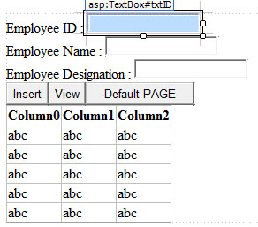
Def. Demonstrate Data Caching…
Step-1
  Create a new website and new web form.
Step-2
  Rename the web form with insert.aspx
  Design the forms as given.

Slide 86
Def. Demonstrate Data Caching…
Step-3
  Create a new database table with name employee with fields id, name, designation.
Step-4
  Proper Code for buttons INSERT (to add new record), View (To display records in gridview), Default page (To redirect page to Default.aspx page).
Step-5
  Create Default.aspx page.

Slide 87
Def. Demonstrate Data Caching…
Step-6
  In Default.aspx insert Gridview control.
Step-7
  Code following for Data Caching.
    Define Connection
    Open Connection
    Define Dataset
    Then CODE FOR DATA CACHE.

Slide 88
Def. Demonstrate Data Caching…
con = new SqlConnection(@“”);
con.Open();
DataSet ds;
if (Cache["employee"] == null)
{ ds = new DataSet();
SqlDataAdapter da;
da = new SqlDataAdapter("select * from employee", con);
da.Fill(ds, "employee");

Slide 89
Def. Demonstrate Data Caching…
Cache.Insert("employee", ds, new System.Web.Caching.CacheDependency( Server.MapPath("Master.xml")), DateTime.Now.AddSeconds(45), TimeSpan.Zero);
con.Close();
}
else
{ ds = (DataSet)Cache["employee"]; }
GridView1.DataSource = ds;
GridView1.DataBind();
}

Slide 90
Cache Expiration Policy :
ASP.NET cache provides a great feature through which we can increase the performance of the website by reducing the server round trips to the database.
We can also cache any serializable data into cache memory.

Slide 91
Cache Expiration Policy :
There are many ways to cache data; one of the simplest way is to use an insert method for storing data in caching.
After data is stored in Cache we need to periodically validate cache and also set the expiration time for cache as data may be updated on the database.

Slide 92
Cache Expiration Policy :
So for that we need to define an expiration time after this defined time the cache will expire and then it will again get the new fresh data from the database into the cache. This method is called as Time Base Expiration.
There are two ways of expiration policy used
  Absolute Cache Expiration
  Sliding Cache Expiration

Slide 93
Cache Expiration Policy :
Absolute Cache Expiration
  Absolute Cache Expiration means that the data from cache will be removed after a fixed amount of time, starting form the time to cache is activated.
  Generally we use this technique when we are displaying data which are not caching frequently.

Slide 94
Cache Expiration Policy :
Sliding Cache Expiration :
  Sliding Cache Expiration means that it expire cache after time period at the time of activating cache and also if no requests are made during this time period.
  This type of expiration is useful in situation where there are many data to cache.
  In this method only those data would be cached which are frequently used in the application. So there is not unnecessary wastage of memory.

